Slide 1



Utilizing Nym’s
Noise-generating mixnet
Protecting patterns of communication for all internet traffic
© 2023 Nym Technologies S.A. | nymtech.net
Notes:
b

Slide 2




A decentralized, incentivized mixnet + private credentials
Nym Mixnet
Nym token (NYM)
The Nym mixnet is a multi purpose mixnet that prevents traffic analysis by an adversary capable of watching the entire network.
Validators ensure fees are paid and are rewarded in NYM proportionally
to the amount of stake and work done signing.
Nym credentials
Nyx Blockchain
Allow 3rd party apps to anonymize any arbitrary ‘key : value’ pairs, so users can privately reveal part or all of their data at their discretion for any authentication.
An IBC and CosmWasm-enabled Cosmos blockchain that allows the usage of zk-nym anonymous credentials.

Slide 3


1.
Multiple hops
Traffic routed through multiple nodes to unlink origin and destination (IP address), like Tor.
2.
Cover traffic
Nym mixnet
Scalable, tunable latency, and generic: As fast and private as required by any app.
Prevents traffic analysis via adding cover (‘dummy’) traffic, with less needed as more real traffic enters the network, unlike Tor.
3.
Timing obfuscation
Packets re-ordered at each hop prevents traffic de-anonymization.
4.
Horizontal scalability
Unlike blockchains, Nym mixnet can expand to allow for more traffic just like the web.

Slide 4
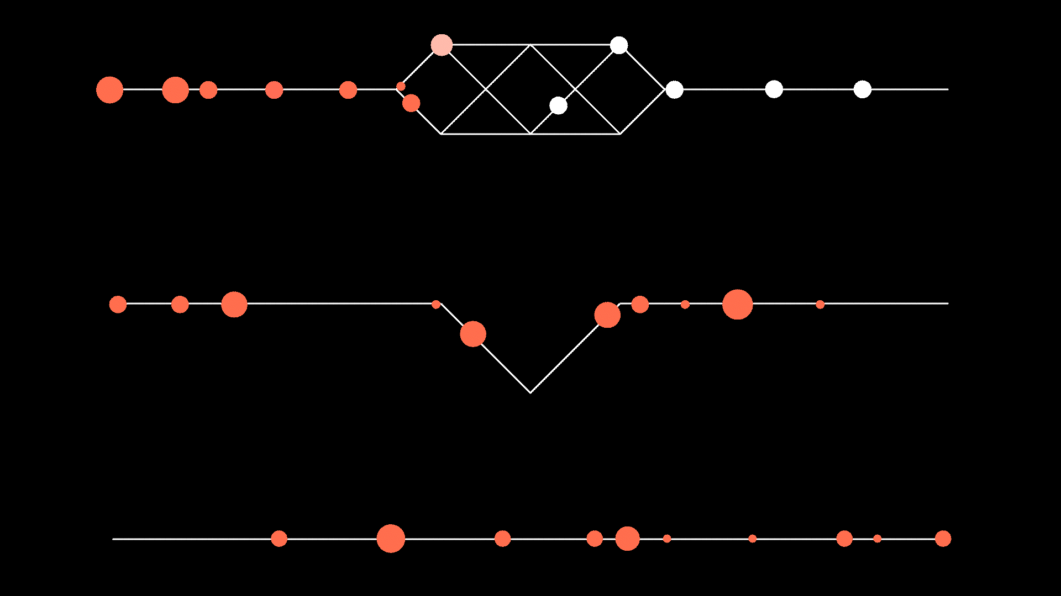


Nym mixnet comparison
You
Nodes
Web destination
Internet Traffic
Nym:
Anonymized packets
Tor:
VPN:

Slide 5
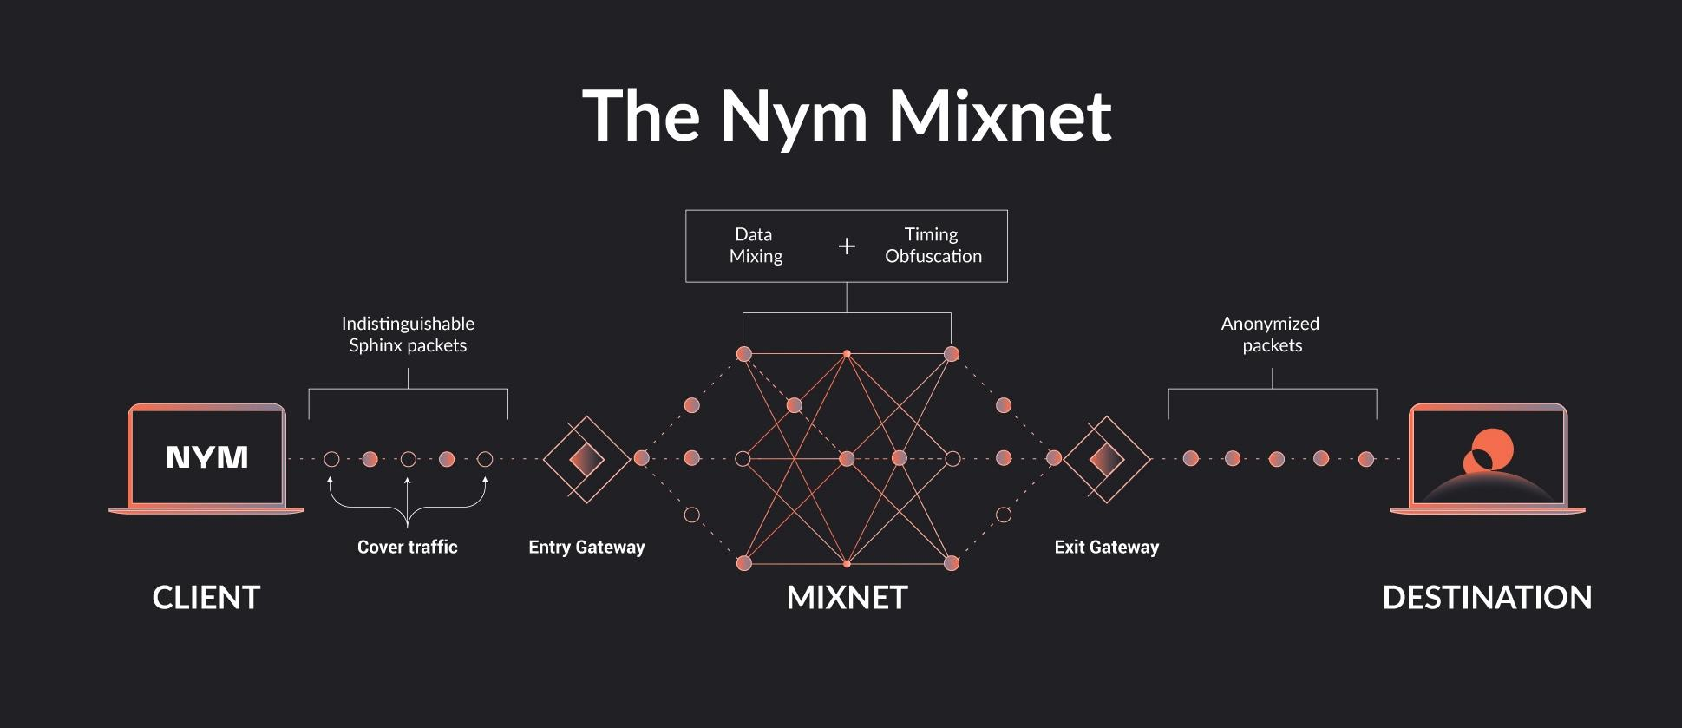

Slide 6
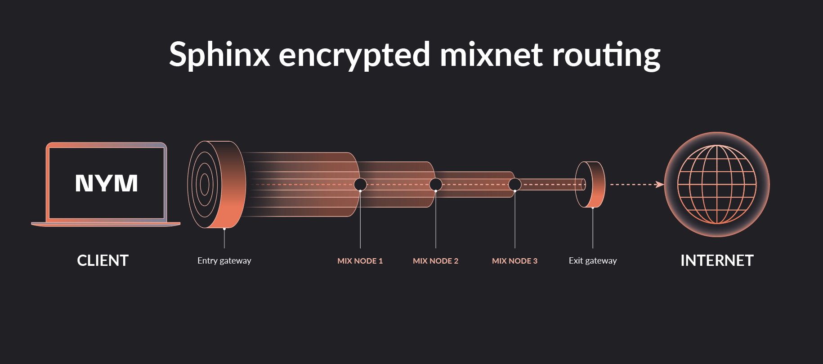

Slide 7
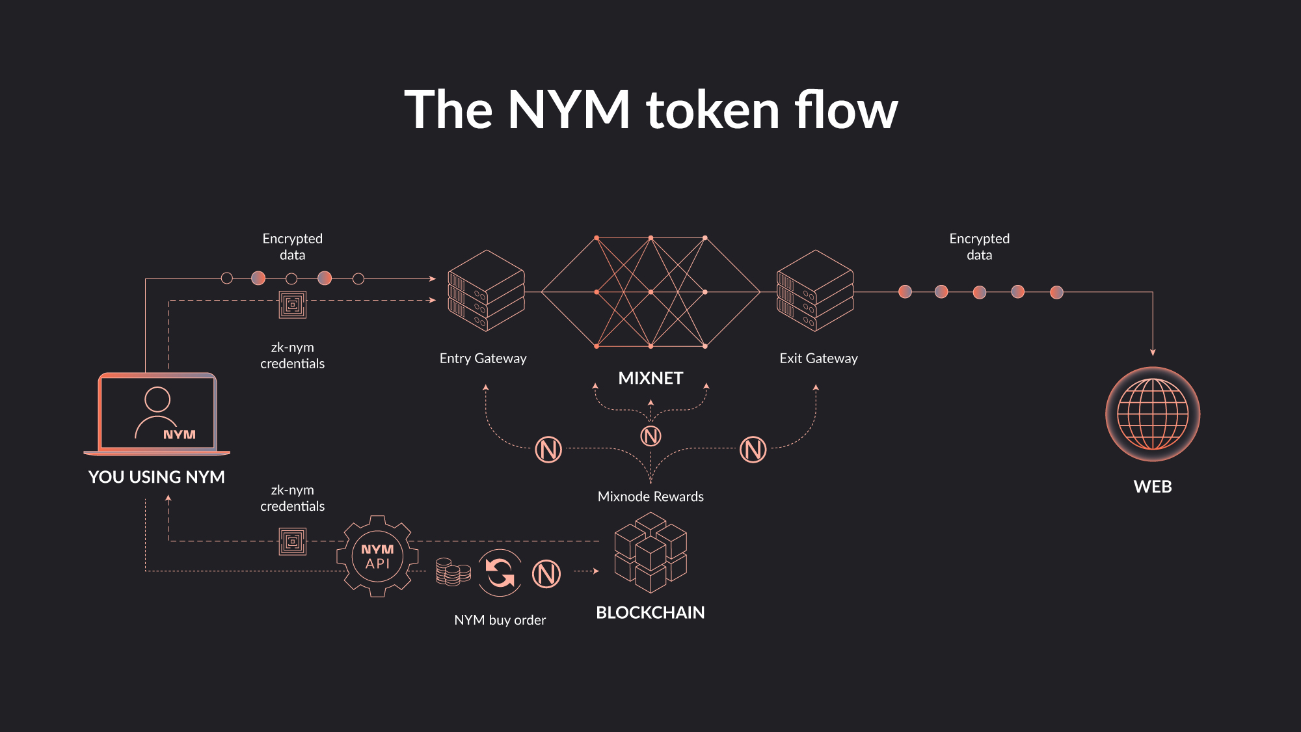

Slide 8
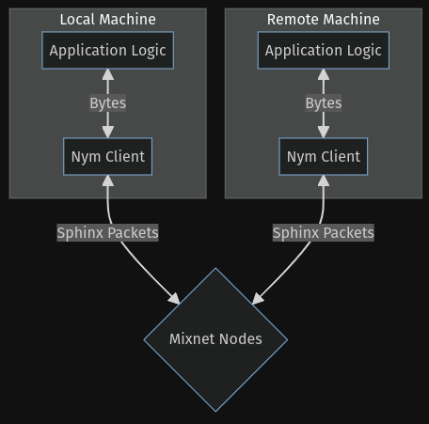



I Want to Play
With Code
https://nymtech.net/docs/developers/rust/mixnet/examples/simple

Slide 9
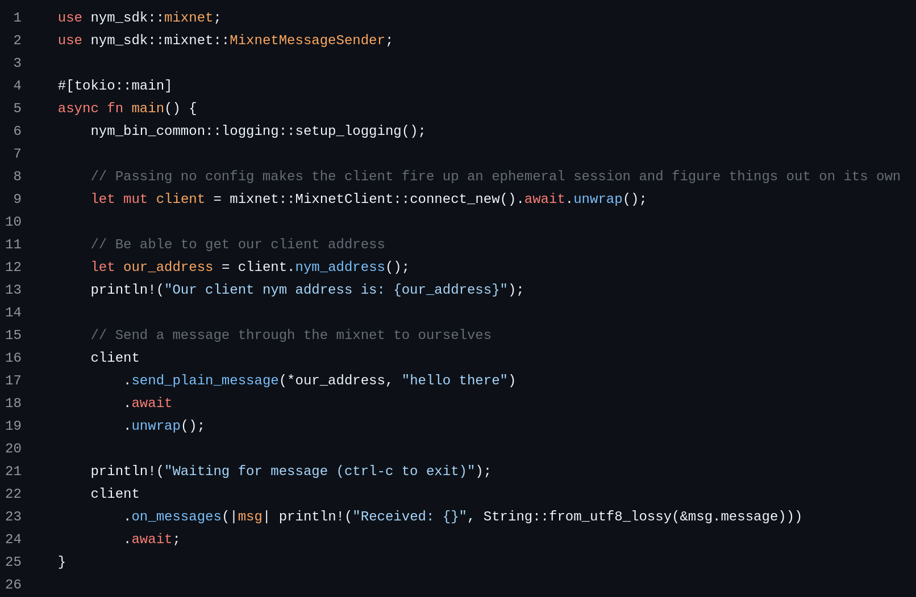
Send & Receive
A Message
https://nymtech.net/docs/developers/rust/mixnet/examples/simple

Slide 10

Mixnet DeepDive

Slide 11









Subscribe to NymVPN
Subscription 123:
public key (= cosmos address)
paid amount
validity (eg, 1 month, 1 year)
fair use limit (eg, 250 GB/month)
consumed GB = 0
payment (fiat, btc, nym)
NymVPN subscription and payment
confirm and create cosmos address for subscription
request ticketbook(s)
client
1. verify request with key of 123
2. if consumed GB < fair use limit:
2.1 issue ticketbook(s) of
requested type(s)
2.2 update consumed GB
entry & exit ticketbooks for mixnet
Notes:
WHY fair use limit is needed: otherwise impossible to stop users from sharing subscription with unlimited others, free riding on the system (and abusing/depleting its resources)
Ticketbook issuance:
Initial issuance of one ticketbook of each type
When running out of tickets of a type: request new ticketbook of that type

Slide 12

subscription
NymVPN subscription and payment
entry & exit ticketbooks for mixnet
Fixed number of tickets per ticketbook (e.g., 100):
mixnet
entry ticket
mixnet
exit ticket
mixnet entry tickets of G_{me} = 100-200 MB each
G_{me} GB
G_{v} GB
mixnet exit tickets of G_{mx} = ?? MB each
Fair use limit (e.g., 250 GB / month):
Mixnet entry and exit tickets consume G_{me} and G_{mx} MB from the fair use limit
mixnet exit tickets must be smaller than WG and mixnet entry
for session unlinkability reasons, i.e.: G_{mx} << G_{me} , G_{v}
However: overhead of validating more tickets if they are smaller
Notes:
QQ: confirm values of G_{mx} , G_{me} , G_{v} being implemented
Ticketbook issuance:
Initial issuance of one ticketbook of each type
When running out of tickets of a type: request new ticketbook of that type

Slide 13


Privacy and security properties of ticketing system
Payment unlinkability and integrity
  No entity can link a ticket to other tickets, the ticketbook or subscription it relates to
  Everyone can verify the validity of a ticket
??
??
??
??
client
Double-spending protection
  Clients that double-spend a ticket reveal the public key of their subscription, which can be voided
    No more ticketbooks issued for that key / subscription !
  Combination of prevention (node checks before accepting the ticket) and detection (checks on all the accepted tickets)
    Probabilistic checking by validators needed for the system to scale
double-spend
reveal
client
Notes:
“security’ in the sense of ”service integrity”

Slide 14
Mixnet creation (re-done every epoch)
Decide on mixnet layer width W
  Taking into account recent mixnet demand (mixnet tickets) and number of eligible nodes

Slide 15
Mixnet creation (re-done every epoch)
Decide on mixnet layer width W
  Taking into account recent mixnet demand (mixnet tickets) and number of eligible nodes
Select 3*W nodes to be mix nodes
  Selection algorithm may consider: high reliability, flags etc. (e.g some nodes may need to always be gateways for censorship resistance service)
mix nodes (3*W)
gateways (N-3*W)

Slide 16

Mixnet creation (re-done every epoch)
Decide on mixnet layer width W
  Taking into account recent mixnet demand (mixnet tickets) and number of eligible nodes
Select 3*W nodes to be mix nodes
  Selection algorithm may consider: high reliability, flags etc. (e.g some nodes may need to always be gateways for censorship resistance service)
All remaining eligible nodes are gateways
  They perform both entry and exit roles (clients must choose distinct e/x per connection!)
gateways
mix nodes

Slide 17
Use of NymVPN in Mixnet mode
M1
M2
M3
R
(payload)
Client selects route per packet
Poisson sending process:
Sends packets according to predetermined schedule
Sends loops of cover traffic when there is no client data to send
Exit gateway:
Uses SURB headers received from client to send data back
mixnet
entry
mixnet
exit
Client selects a mixnet entry and a mixnet exit from the eligible mixnet gateways
kept the same for all packets of a session
Mix nodes are randomly chosen per packet:
different route per packet
one mix node per layer
chosen uniformly at random
At each mix node:
packets are decrypted (appearance changed)
packets are randomly delayed (reordered)
SURB: Single Use Reply Block
Notes:
Unobservability (Poisson + cover traffic)
Latency: propagation, mixing, processing
Reordering: exponential distribution, TUNEABLE
SURBS: created by client, empty boxes

Slide 18
Mixnet use
Client selects entry gateway G_{e} and spends mixnet entry ticket with G_{e}
  G_{e} commits to forwarding up to G_{me} GB from the client to the mixnet (upstream traffic, orange arrows) and deliver to client any received traffic
    Note: downstream (received by G_{e}) traffic does not consume data from the entry ticket !
mixnet
entry ticket
mixnet
exit ticket
G_{me} GB
G_{mx} GB
2. Client selects exit gateway G_{x} (<>G_{e} !) and spends
mixnet exit ticket with G_{x} sending the ticket through
the mixnet when establishing session
  G_{x} will forward up to G_{mx} GB from the final destination to the client, through the mixnet (downstream traffic, blue arrows) using SURBs
    Note: upstream (received by G_{x}) traffic does not consume data from the exit ticket !
  Update G_{x} frequently to have unlinkability of sessions, while G_{e} may be maintained for extended periods of time
(1)
G_{e}
G_{x}
(3)
(2)
(2)
3. Each gateway collects during the epoch:
  t_{me} mixnet entry tickets
  t_{mx} mixnet exit tickets

Slide 20
Client privacy in mixnet mode
Recipients (eg, websites) cannot identify the client or see its IP address
Mixnet exit gateway cannot identify
  the client and its IP address
  the mixnet entry gateway used by the client (thanks to intermediate mix nodes and to SURBs)
Mixnet exit gateway cannot trivially relate two exit tickets as coming from the same client
  It can link together all the destinations accessed with one ticket as coming from the same client --- thus: changing exit mixnet gateway with each new ticket is good for unlinkability
Mixnet entry gateway cannot see:
  the clients’ activity (accessed recipients)
    Website Fingerprinting attacks may help infer downloaded pages (however not so easy in practice for a mixnet)
  the mixnet exit gateway used by the client (thanks to intermediate mix nodes)
  whether the client is actually communicating (thanks to cover traffic)
Intermediate mix nodes:
  cannot tell if two packets are from the same client or different clients
  can only see their own predecessor and successor in the route of each packet (cannot identify client or destination)
If a connection’s mixnet entry and exit gateways collude, they may be able to figure out they are part of the same connection via:
  Machine learning (passive) attacks that become more accurate with the number of packets exchanged in the flow
  Active traffic confirmation attacks
A global network adversary that sees all connections is(?) not able to link client to destination
Notes:
Biggest risk to privacy of clients: adversaries running nodes: in Tor, permissioned system (Directory Authorities), for us, best defence is an engaged community of operators such that it is not so easy/fast/cheap for an afversary to becomea large part of network.
Tension between ease of growth and vulnerability to adversaries running nodes
for b2b: they may want to have “semi-trusted” operators rather than random people from the internet

Slide 21
NymVPN:
1st application built on the Nym Mixnet
3rd party apps
Nym Wallet and NYM token
NymVPN
Nym future B2C /
B2B apps
Private mixnets
Nym SDK
Nym privacy platform
Mixnet
zk-nyms
Future capabilities
Mixnet

Slide 22
Mixnet Demo
Using the rust SDK

Slide 23
Ready to
Get Started!
https://nymtech.net/docs/developers/rust/mixnet/examples/simple

Slide 24
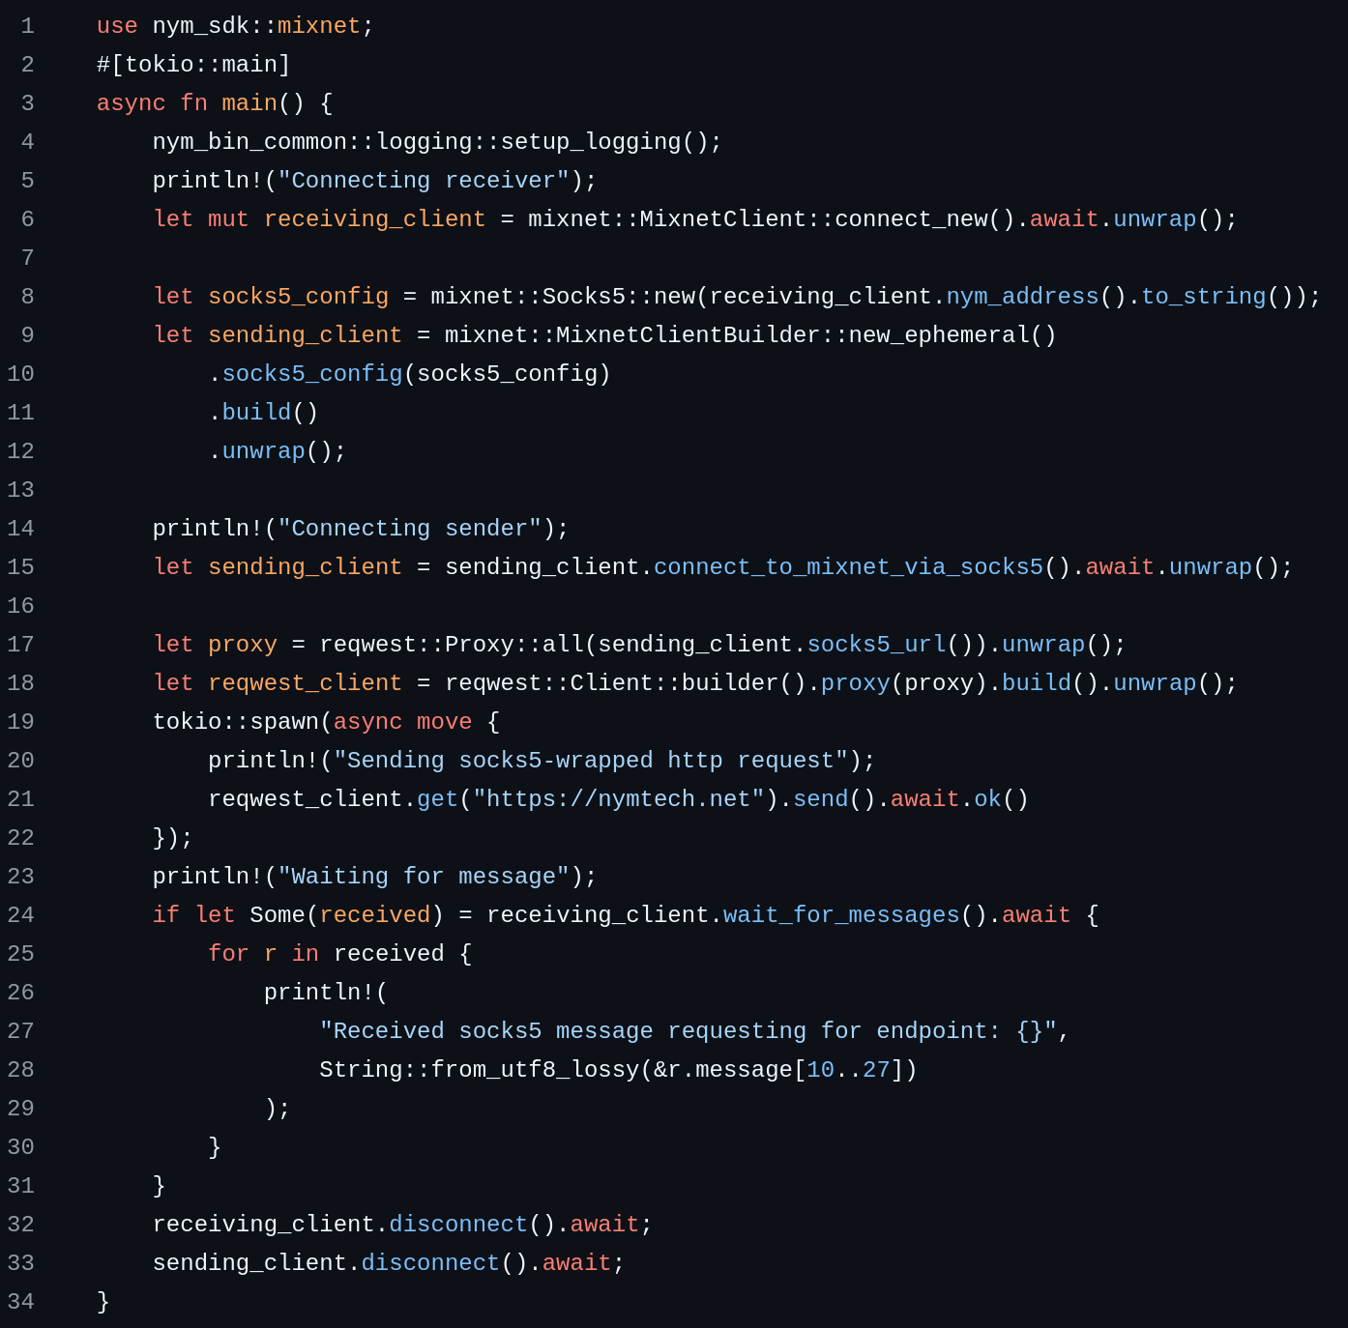

Send Yourself a
Socks5 Message
https://github.com/nymtech/nym/blob/develop/sdk/rust/nym-sdk/examples/socks5.rs

Slide 25
Getting Involved

Slide 26
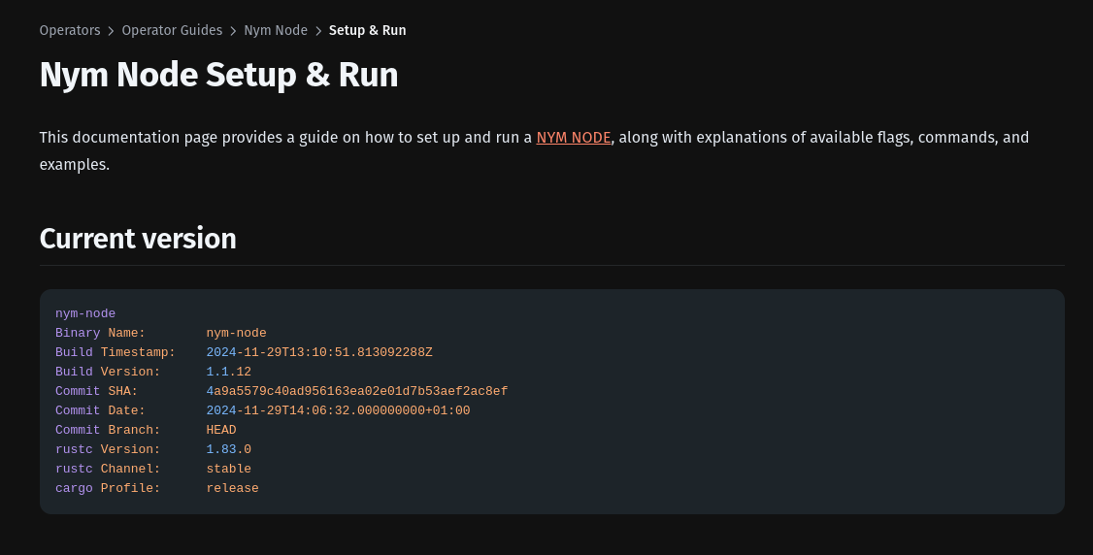

Running A Node
https://nymtech.net/docs/operators/nodes/nym-node

Slide 27


Buying & Staking NYM Tokens
https://nymtech.net/docs/developers/tools/nym-cli\
#staking-on-someones-behalf-for-custodians

Slide 28




THANK YOU
Download
NymVPN
Connect with
the Community
https://nymvpn.com/download
https://t.me/nymtech

