Slide 1




Designing obfs5
SplinterCon Berlin - Dec 2024
Building a successor to the obfs4 randomizing transport.
© 2023 Nym Technologies S.A. | nymtech.net
Notes:
b

Slide 2

Jack Wampler
R&D Circumvention @ NYM
Ph.D. in Computer Security from CU Boulder, specialist in circumvention transport design.

Slide 3



Network Privacy Tools
You
Nodes
Apps/services
Gateway Connection
VPN:
Tor:
Nym:

Slide 4








Getting Connected
Zknym credentials
Encrypted data
Encrypted data
You
Entry
Gateway
Exit Gateway
Web
Mixnet
Mix node rewards
Zknym credentials
NYM buy order
Nyx Blockchain

Slide 5


Getting Connected
Transports
You
Entry
Gateway

Slide 6

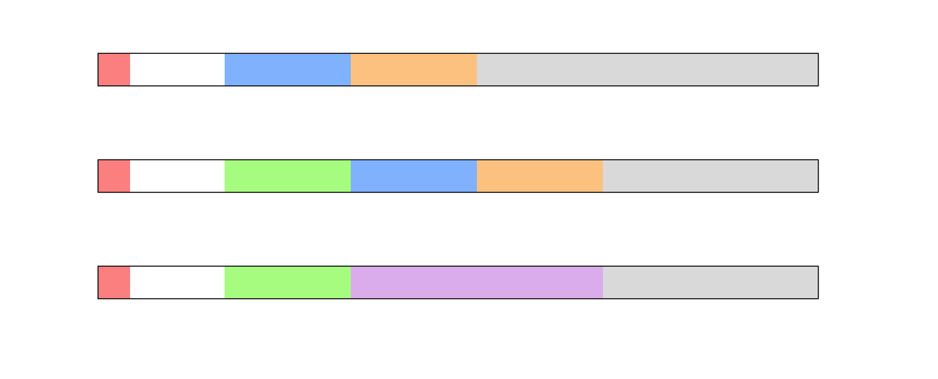
Getting Connected

Slide 7
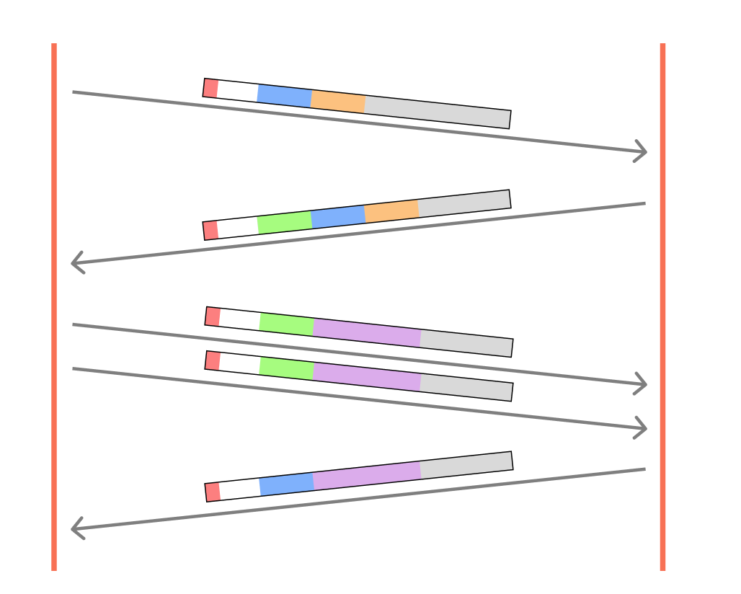

Distinguishable VPN Transports are
Easy to Block
Transports
You
Entry
Gateway

Slide 8

obfs4
(The obfourscator)

Slide 9
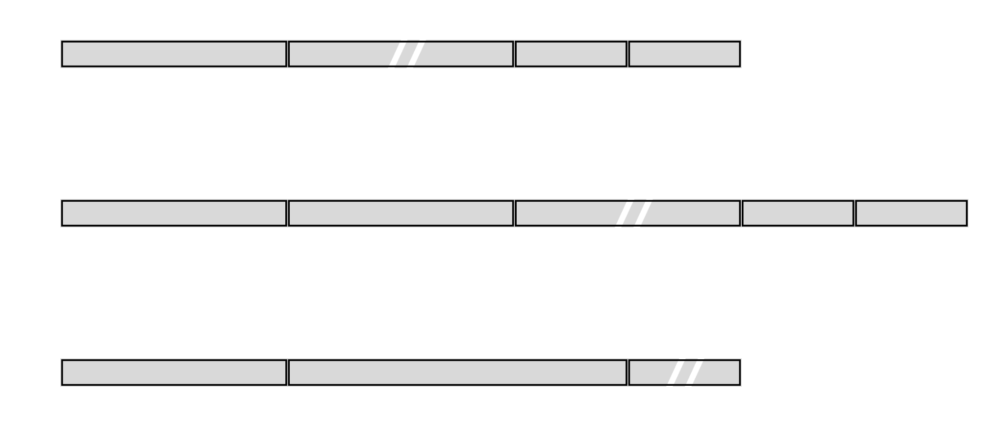
obfs4 Packet Format

Slide 10
Forward Secrecy
Session keys will not be compromised even if long-term secrets used in the session key exchange are compromised.
Replay Resistance
If a network adversary records and replays a legitimate flow it will FAIL to establish a connection.
Probe Resistance
Network adversaries scanning the internet without the server’s identity public key should be unable to illicit a unique, distinguishable response.
Fingerprinting Resistance
Conceal or obfuscate the shape of the underlying traffic. Includes features like Packet Size, Inter-Packet timings, flow burstiness, etc.
obfs4
The Good

Slide 11
obfs4
The Bad
XSalsa20Poly1305 only
The only cipher / AEAD supported by obfs4 is XSalsa20Poly1305
No Hardware Accelerated Cryptography
No newer iterations like XChaCha20Poly1305
NTor v1 => No Early Data
The obfs4 handshake closely follows the NTor version 1 handshake.
Requires Reliable & Ordered Channel (TCP)
Servers are forced to acknowledge (SYNACK) incoming connections before clients indicate any knowledge of the server’s key material (or lack thereof).
Does NOT provide Strong Obfuscation
…

Slide 12


Strong Obfuscation
Traffic must be
Computationally Indistinguishable from Random
even to an adversary that knows the Server’s Public Identity,
(but not the session or identity secrets).
Obfuscated Key Exchange by Günther, Stebila, and Veitch

Slide 13
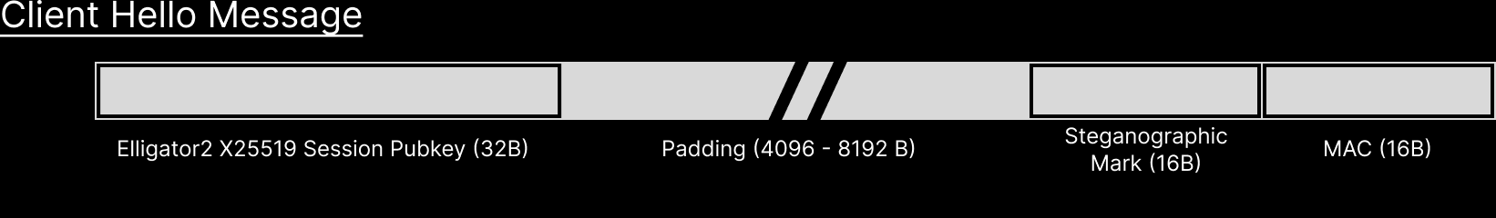
obfs4 Doesn’t Have Strong Obfuscation
Traffic must be Computationally Indistinguishable from Random even to an adversary that knows the Server’s Public Identity.
Public Key (x25519 - 32B), Identity (20B)
HMAC( Server_ID_PUB , ClientHello Message ) = MAC

Slide 14
Obfs5
Keep the good & improve from there

Slide 15
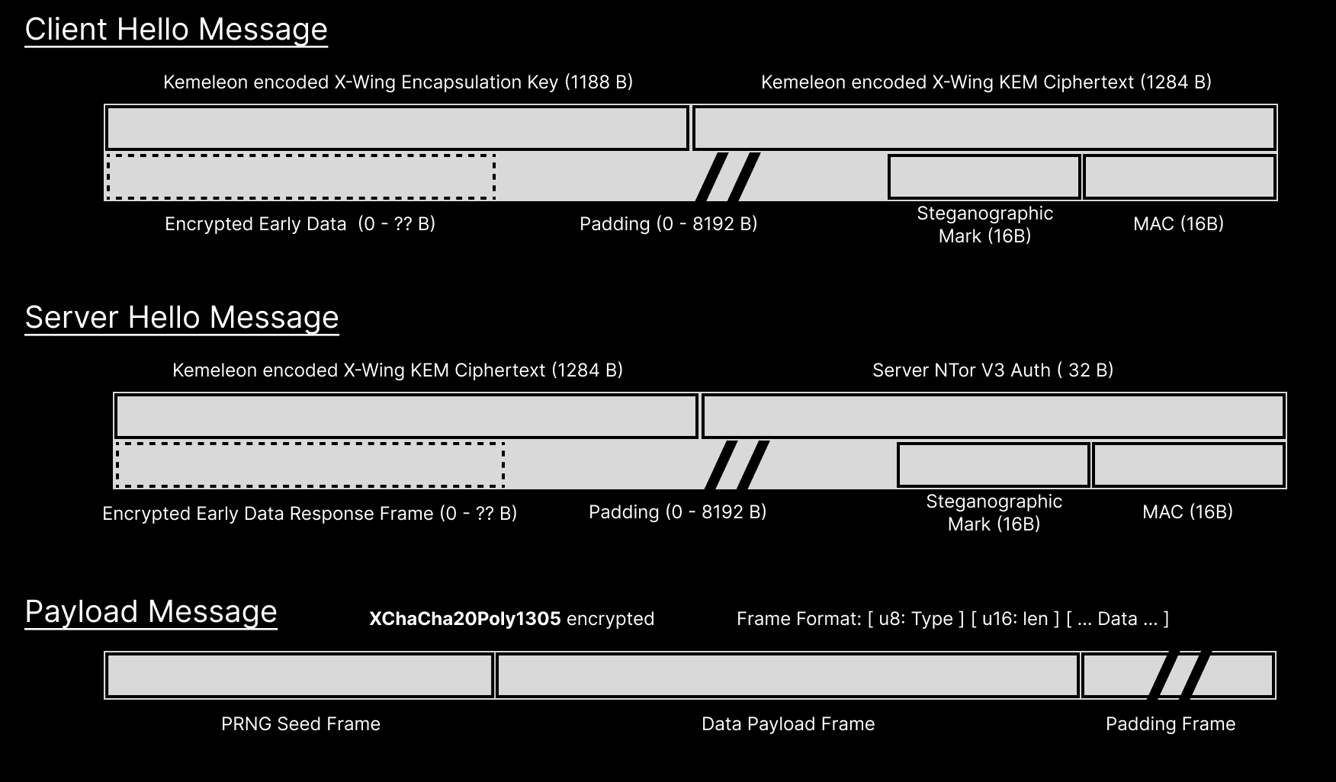
Strong Obfuscation
Public Key (B), Identity (ID)
B ^{x} = Ephemeral_Secret
HMAC( Ephemeral_Secret, ClientHello Message ) = MAC
Client Session Keys (x, X)
Obfuscated Key Exchange by Günther, Stebila, and Veitch

Slide 16
Forward Secrecy
Replay Resistance
Probe Resistance
Fingerprinting Resistance
Strong Obfuscation
XChaCha20Poly1305
obfs5

Slide 17
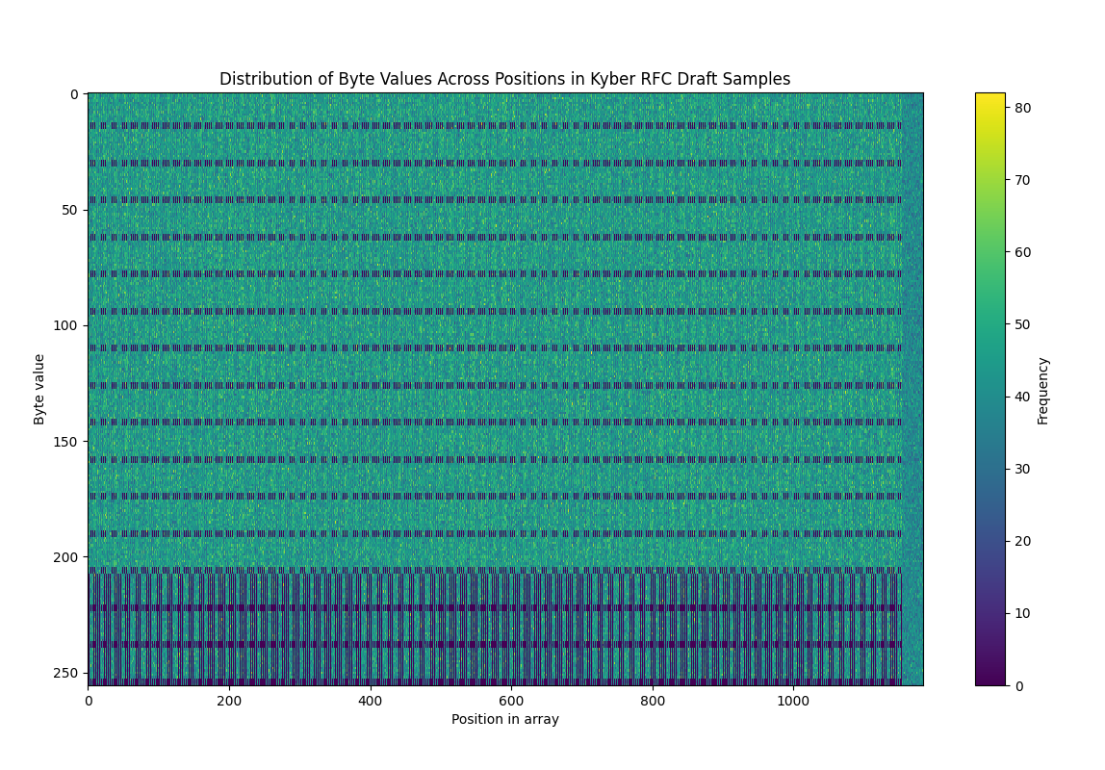
Post Quantum Cryptography
Kyber & ML-KEM are
Distinguishable from Uniform Random
The encoding scheme for Kyber (and ML-KEM) keys has a uniquely identifiable pattern.
=> Kemeleon!
The proposed Kemeleon encoding scheme* allows ML-KEM (and Kyber) Encapsulation Keys and Ciphertexts to be serialized indistinguishably from uniform random.
*Obfuscated Key Exchange by Günther, Stebila, and Veitch

Slide 18

Post-Quantum Forward Secrecy
Traffic stored today cannot be decrypted at a future date without access to the session secret keys, even if the adversary has access to a quantum computer.

Slide 19
Forward Secrecy
Replay Resistance
Probe Resistance
Fingerprinting Resistance
Strong Obfuscation
XChaCha20Poly1305
Post Quantum Forward Secret
obfs5

Slide 20
X-Wing = ML-KEM + ECDHKEM
HPKE &
Hybrid Key Establishment
As suggested by many cryptography experts, hybrid key establishment schemes are the safest options in the transition to Post-Quantum primitives.
By combining Elligator2, Kemeleon, and X-Wing we have a fully obfuscated Hybrid KEM.
X-Wing: The Hybrid KEM You’ve Been Looking For - Barbosa et. al

Slide 21
Forward Secrecy
Replay Resistance
Probe Resistance
Fingerprinting Resistance
Strong Obfuscation
XChaCha20Poly1305
Post Quantum Forward Secret
  HPKE / Hybrid KEM
obfs5

Slide 22
HS Extensions
Early Data
Granular Permissioning
By using NTor V3 as a starting point for the obfs5 handshake we gain the ability to include client data in the ClientHello message (encrypted under the node’s identity key).
With obfs4 you had to wait for the handshake to complete to receive the first data packet to check for a UUID or password. Extensions allow this to be sent in the first message.
AEAD Options
If Clients wish to use an AEAD other than the default a Client Handshake extension now allows them to do so. This allows devices that support it to enable Hardware Accelerated Cryptography.
Other ??
Extensions are made available to downstream libraries for their own use.

Slide 23
Forward Secrecy
Replay Resistance
Probe Resistance
Fingerprinting Resistance
Strong Obfuscation
XChaCha20Poly1305
Post Quantum Forward Secret
  HPKE / Hybrid KEM
Supports Early Data
  Hardware Accelerated Crypto (AEAD options)
  Granular Permissioning
obfs5

Slide 24

Implementation

Slide 25
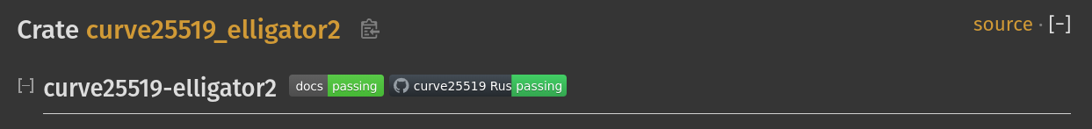
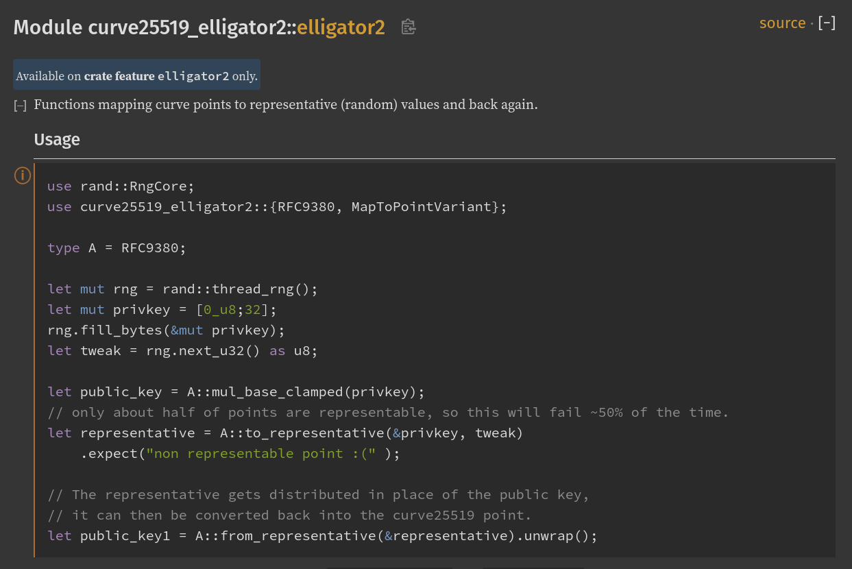
Implementations
Elligator2 (curve25519-dalek)

Slide 26
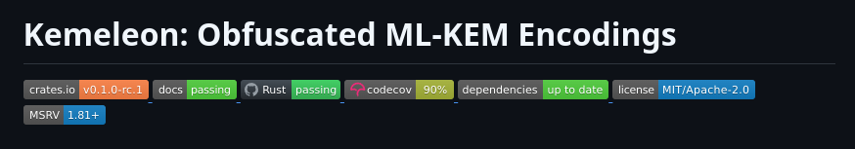
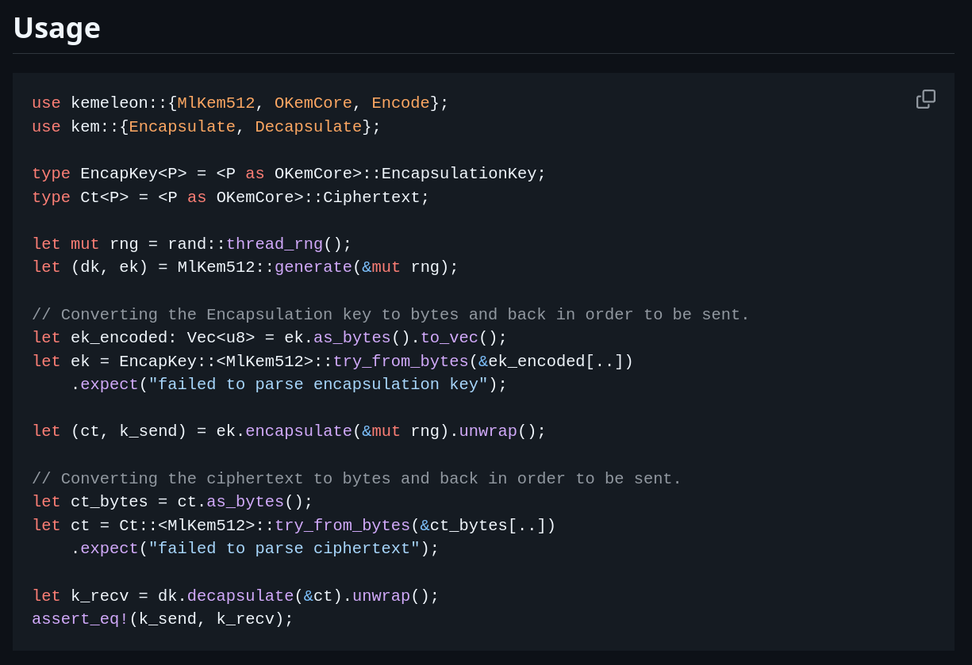
Implementations
Elligator2 (curve25519-dalek)
Kemeleon (ML-KEM)

Slide 27
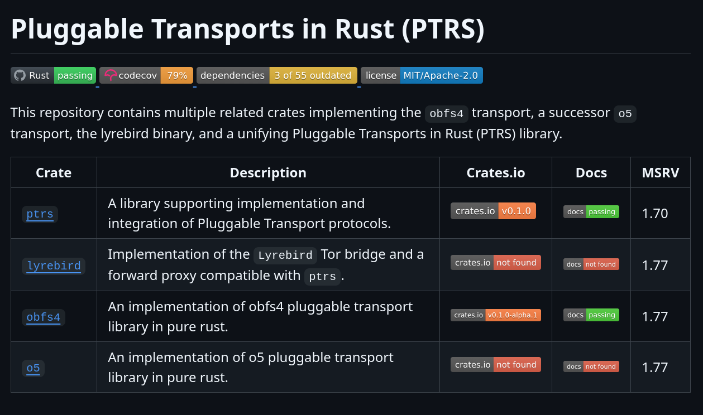
Implementations
Elligator2 (curve25519-dalek)
Kemeleon (ML-KEM)
obfs4, obfs5, PTRS
⚠️ These implementations are still experimental ⚠️
and may be incomplete

Slide 28


Thinking Above and Beyond
Looking to Quic for potential transport features
Auth in Packet #0
Tunnel Multiplexing
When using TCP, the server is forced to acknowledge incoming connections (SYN/SYNACK) without any Auth
Multiple Independent streams can be opened over a single tunnel.
What would you like to see?
Let’s chat!
Internal Reliability
Session Migration
Prevent external entities from tearing down connections by inserting (RST) messages.
Tunnel flows are tracked by an internal ID allowing IP/Port to change.
Support RTC traffic
Session Resumption
For traffic that suffers when using a reliable protocol (e.g media streaming), disable reliability features.
Mix nodes are rewarded in NYM proportionally

Slide 29






THANK YOU
Email: jack.wampler@nymtech.net Github: @jmwample Web: nymtech.net
github.com/jmwample/kemeleon
Obfuscated Key Exchange
by Günther, Stebila, and Veitch
Kemeleon rust for
ML-KEM & X-Wing
github.com/jmwample/ptrs
/tree/main/src/crates/o5
github.com/jmwample/curve25519-dalek
/tree/main/curve25519-elligator2
Obfs5 & PTRS
Elligator2 rust

Slide 30
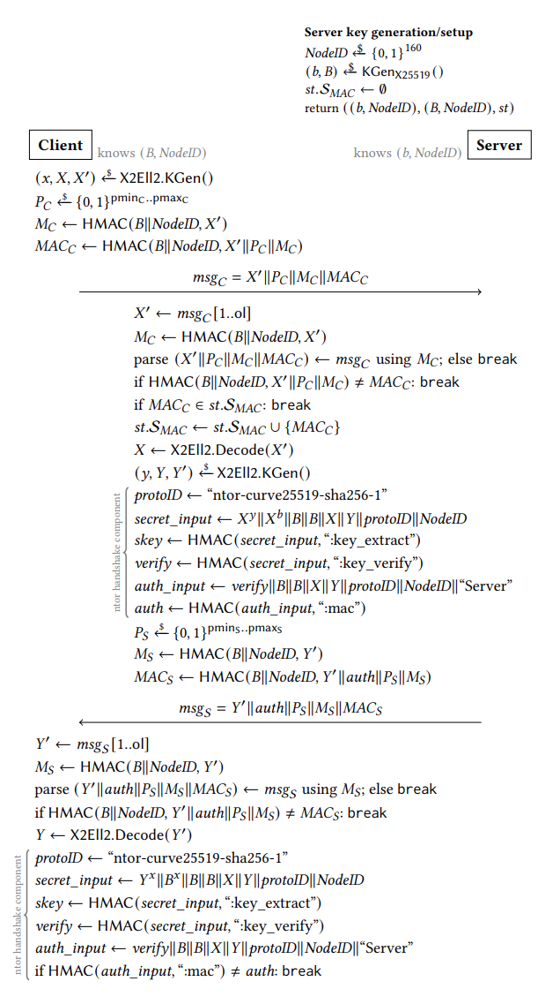
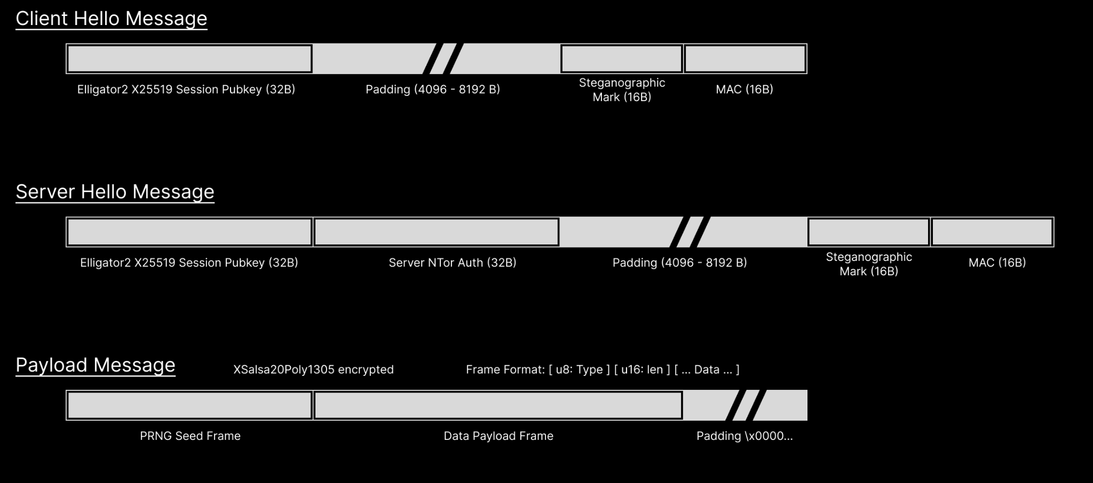
obfs4 Packet Format

Slide 31
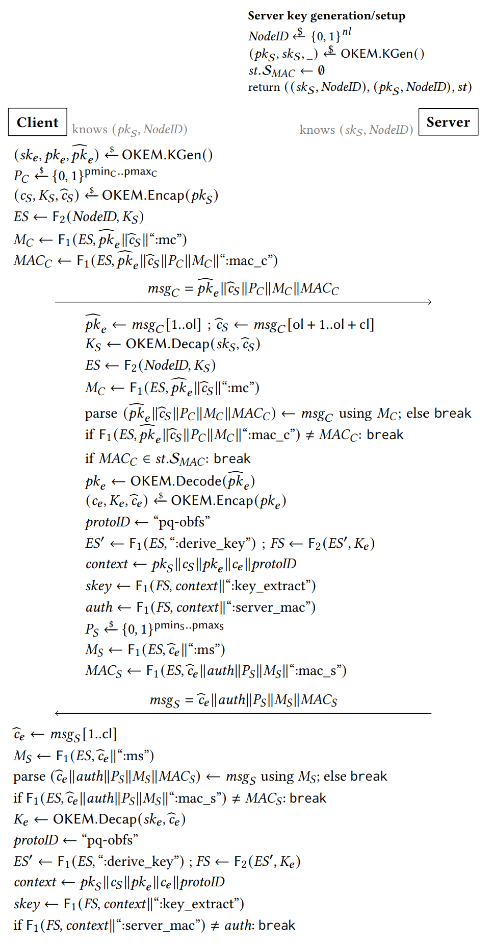

obfs5 Packet Format

Slide 32
obfs-KEM
Handshake
Comparison
obfs4

Slide 33


Mixnet deepdive
Data
mixing
+
Timing Obfuscation
Hello
Indistinguishable
Sphinx packets
Anonymized
packets
Hello
Client
Entry Gateway
Exit Gateway
Destination
MIXNET

